Slide 1

Unit 4.2 Assignment Technical Presentation exercise Chad cooper

Slide 2

AGENDA
INTRODUCTION
Social media
regulation
Your right to Political truth
TAKEAWAYS
Notes:
Intro-
We hear from our political leaders all the time—on TV, in speeches, and especially on social media. But have you ever stopped to think about how they’re talking to us, who’s keeping an eye on what they say, and whether anyone should be?
In this presentation, we’re going to take a closer look at political speech—how it works, how it's changing, and why it matters. We'll dive into the role of social media in spreading political messages, explore whether political speech should be regulated (and if so, by whom), and talk about your right to hear the truth when it comes to politics.
At the end of the day, this isn’t just about politicians—it’s about us. Our right to political truth is a big part of what keeps our republic going. Let’s talk about your right to poltical truth.

Slide 3
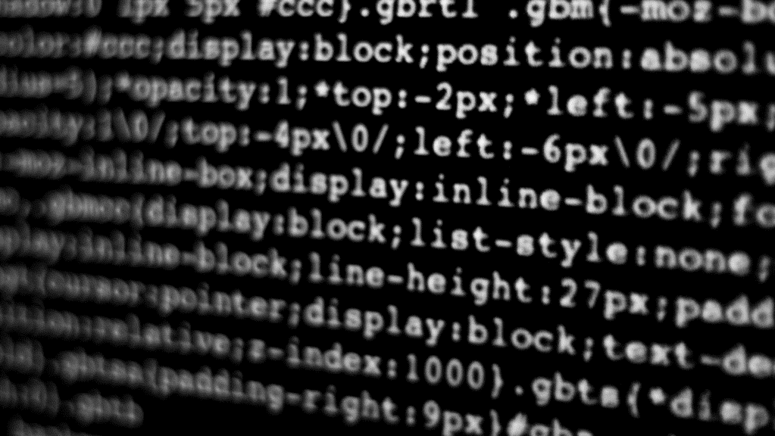
Social media: your right to truthful political speech

Slide 4
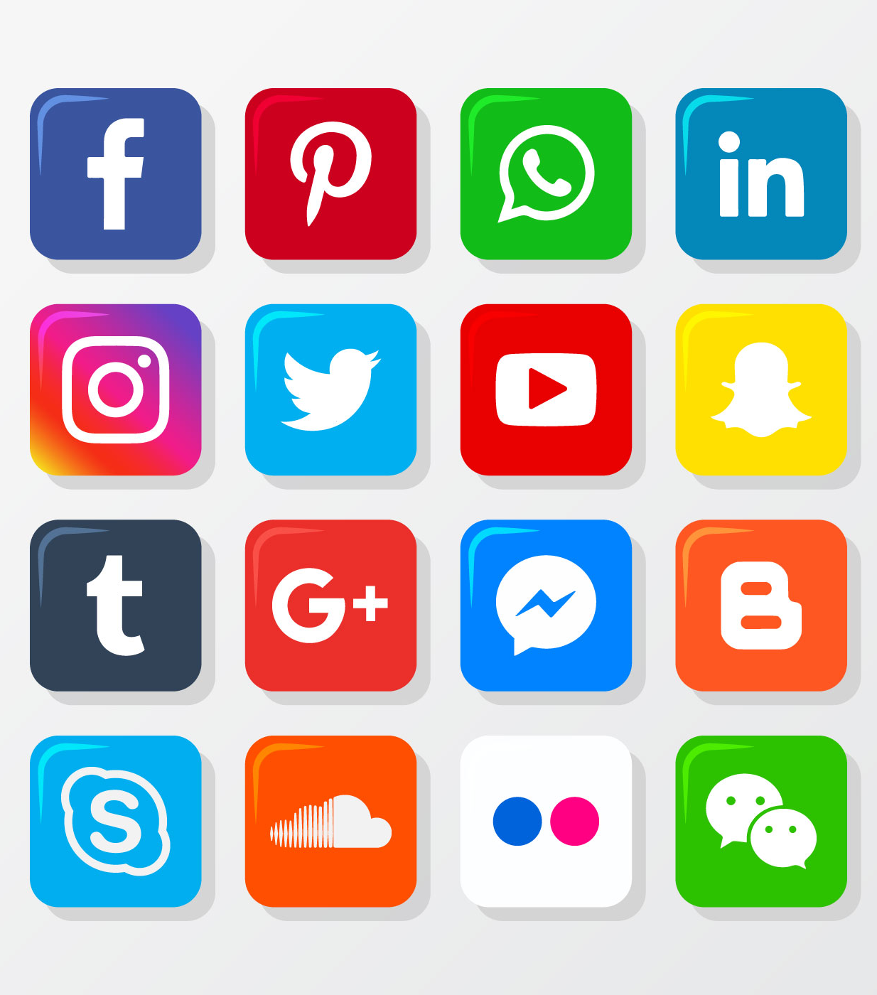
Social Media
The civil discourse medium
This Photo by Unknown Author is licensed under CC BY-SA

Slide 5
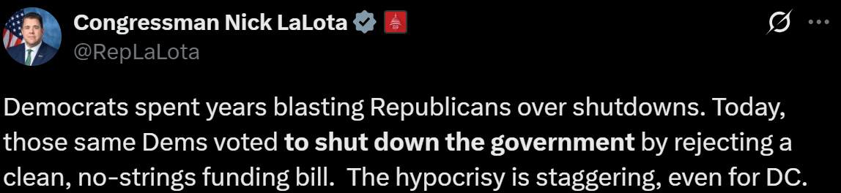
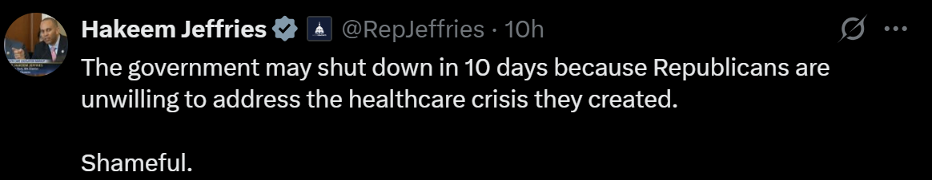
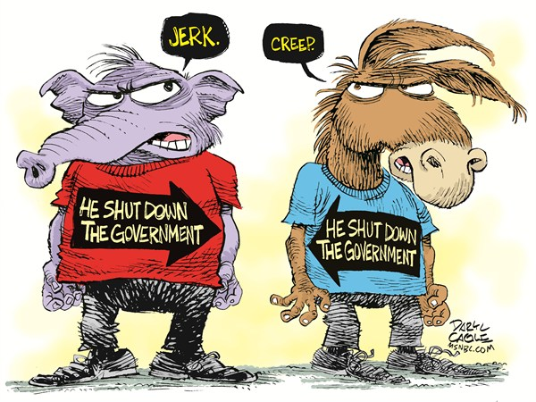
How our leaders communicate with us
Facebook- approximately 2.1 billion daily active users, making it the largest social network globally
X- 245 million MAU (does not update user data often)
Instagram- approximately 2 billion MAU
Youtube- around 2.53 billion MAU
Tiktok- over 1.5 billion
Traditional media (newspaper, radio, TV)- newspaper under 21 million, radio 288 million , TV 128 million
This Photo by Unknown Author is licensed under CC BY-NC-ND
Notes:
A quick internet search will show where the average person receives their media. As we rapidly expand the reach and accessibility of technology, we also adopt new ways to access information more quickly. 97% of all Americans own a cell phone. Every single medium listed on this slide has a mobile application for ease of access. Our government even interacts with us through an emergency alert system that sends notifications about weather, kidnappings, and road closures. The point is, we have migrated from traditional sources and not only embraced the speed at which these new forms of communication have given us, but we demand it. So, if we have moved in this direction, why wouldn’t our leaders also embrace it and speak to us through these mediums?

Slide 6
regulation
Who, how, and why it matters

Slide 7
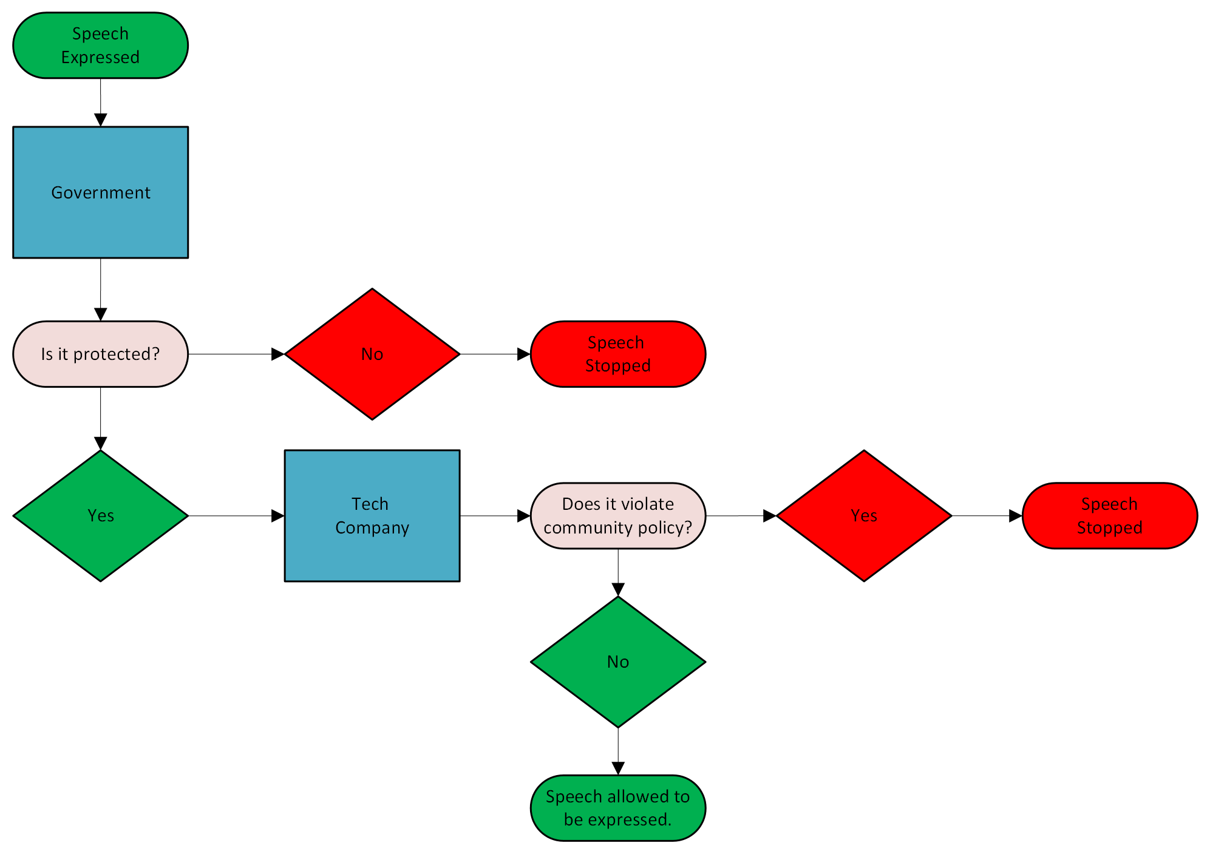
Government and tech companies How they regulate speech
Notes:
The simplest breakdown of how our speech gets regulated is expressed in this flow chart. However, it is much deeper than this and ever-changing. When you tweet, snap, or post, your message is put in an algorithm that asks and answers these questions before it is viewable.
The government regulates speech through legislation or by putting pressure on Media companies. Media companies take what they get from the government and align it with their own views on what should be allowed on their platforms, and make community guidelines for all users to adhere to.

Slide 8
Your right to political truth
Are we getting it

Slide 9
what kind of truth are we getting
Research both all sides
Research the ways a company regulates speech
Don’t take everything presented at face value
What we see is not always what was input
Notes:
Knowing the source of information and what kind of filters or regulations it faced before you view it matters. It lets you know what to trust and what to discard. Like the “Transformers” motto, “More than meets the eye”

Slide 10
Summary
Social Media
Leaders speaking directly to the masses
Government and Tech companies Regulate
Bills, legislation, community guidelines
Your right to Political Truth
You have to take the reins to find the truth buried in regulation
Notes:
Every political leader uses social media today. Make sure you’re researching what they are saying and always consider the source and platform they utilize. This ensures you have the most unadulterated speech available. The more you know, the better equipped you are for making your choices.
Government and Tech will continue to push regulations and guideline updates, making calls to regulate speech in the interest of the greater good. No matter what either entity pushes, all speech is free, and you have a right to hear it.

